Slide 1
Course Project
Operating Systems
Module 2 Linux Filesystem Hierarchy

Slide 2
Rubric
Activity | Requirement(s) | Points
Navigate the Linux filesystem tree | Answer two questions | 12
Create directories and files | Take a screenshot | 6
Copy and remove directories and files | Take a screenshot | 6
Locate directories and files | Take a screenshot | 6

Slide 3
Navigate the Linux filesystem tree
1. What is the pwd command an acronym for? What about the cd command?
Answer here:
Present working Directory
Change Directory
2. Explain the differences between a relative path and an absolute/full path in Linux.
Answer here:
absolute path is a complete path from start of actual file system from / directory.
Relative path is defined as the path related to the present working directly(pwd)
References:
1.Google
2. https://www.geeksforgeeks.org/

Slide 4
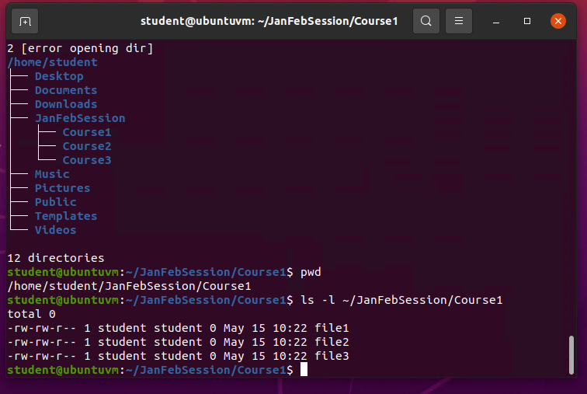
Create directories and files
Take a screenshot of the output in Steps 5 and 6.

Slide 5
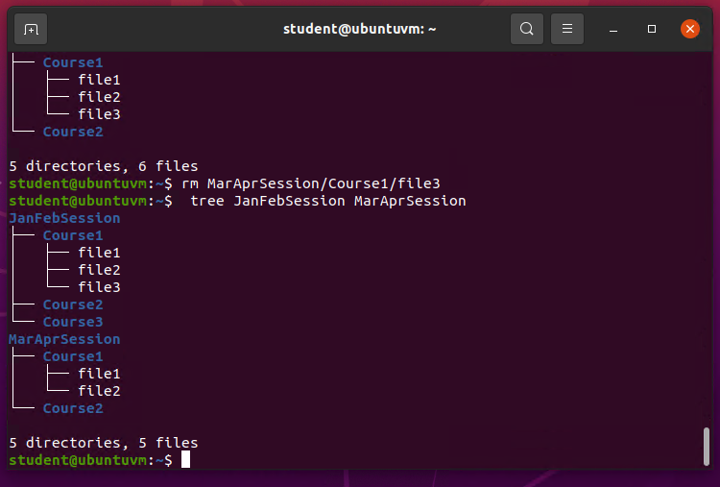
Copy and remove directories and files
Take a screenshot of the output in Step 3.

Slide 6
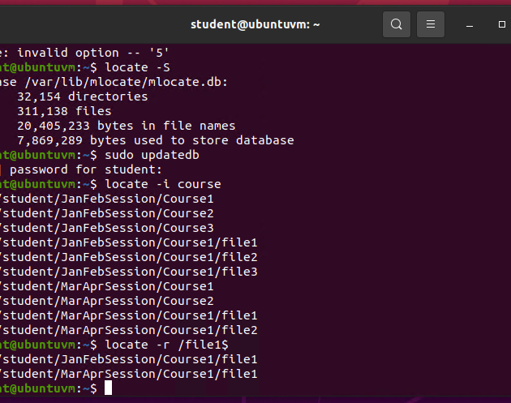
Locate directories and files
Take a screenshot of the output in Steps 5 and 6.

